Slide 1
Title
MONASH LIBRARY
Learning activity – Hot Spot
Using the Adobe Presenter plugin on PowerPoint
Click Preview under the ADOBE PRESENTER tab to see activity.

Slide 2
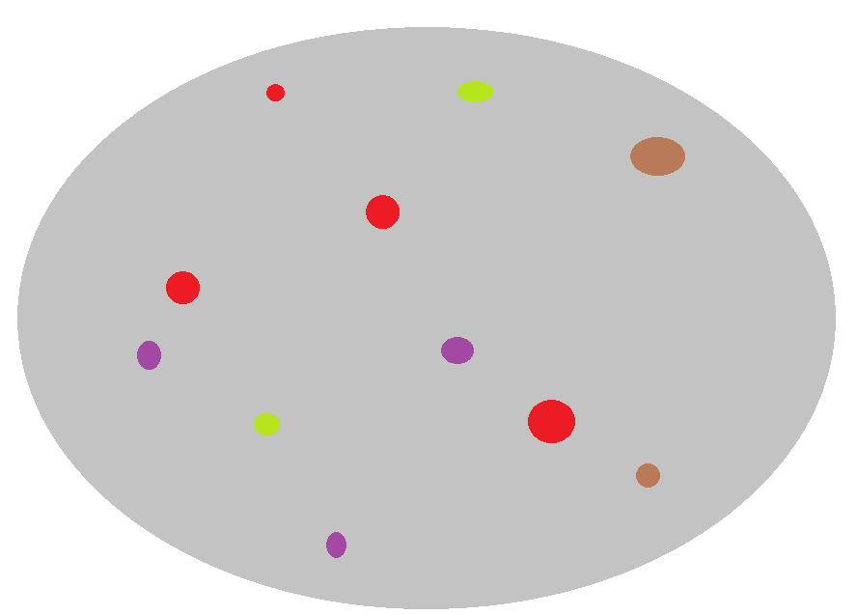
Hot Spot Question
Click on the red dots.
You must answer the question before continuing
Correct - Click anywhere or press Control Y to continue
Try again
Submit
Clear

Slide 3
Hot Spot Question
Your Score | {score}
Max Score | {max-score}
Number of Quiz Attempts | {total-attempts}
Question Feedback/Review Information Will Appear Here
Continue

Slide 4
Instructions
Learning Activity – Hot spot
Instructions
To change the settings of this quiz, click on ‘Manage’ under the ADOBE PRESENTER tab. Select the quiz you wish to customise and click ‘Edit’.
To change the settings of this question, click on ‘Manage’ under the ADOBE PRESENTER tab. Select the question you wish to customise and click ‘Edit’.
To customise the look of the message boxes, click on the box you wish to change and click the FORMAT tab.
To add an image, click the INSERT tab and click ‘Pictures’. Arrange the hot spots on top of the image.
To make the hot spots invisible, click on each hot spot square and click the FORMAT pictures tab, then change the ‘Picture border’

